Slide 1
DIAZONIUM SALTS

Slide 2
DIAZONIUM SALTS
The diazonium salts or diazonium compounds are the class of organic compounds with general formula R−N₂⁺X⁻. Here, X is an organic or inorganic anion (for example, Cl–, Br–, BF₄–, etc.) and R is an alkyl or aryl group. The term is derived from two words. ‘di’ refers to ‘two’, azo is indicative of ‘nitrogen’ and ium implies that it is cationic in nature.
Hence, they have two nitrogen atoms with one being charged. Benzenediazonium chloride (C₆H₅N₂⁺Cl–), benzene diazonium hydrogen sulfate (C₆H₅N₂⁺HSO₄–), etc. are some of the examples of the diazonium salt.

Slide 3
PROPERTIES OF DIAZONIUM SALTS
They are ionic in nature.
They are water soluble.
Aryl diazonium salts are colourless crystalline solids.
Benzene diazonium chloride is soluble in water. But, it reacts with it only when warmed.
Benzenediazonium fluoroborate is not soluble in water.

Slide 4
STABILITY OF AROMATIC AMINES

Slide 5
Importance of Diazonium Salts
We use diazonium salts in the dye and pigment industries. They play a major role to produce dyed fabrics.
They are useful in the synthesis of a large variety of organic compounds, especially aryl derivatives.
Direct halogenation is not a suitable method for preparing aryl iodides and fluorides. Nucleophilic substitution of chlorine in chlorobenzene by a cyano group is not possible. However, we can use diazonium salts to produce cyanobenzene easily.
It is not possible to prepare substituted aromatic compounds by direct substitution in benzene. For these compounds, we use replacement of diazo group in diazonium salts.
They are essential as intermediates for introducing –F, –Br, –Cl, –I, –NO₂, –OH and –CN groups into the aromatic ring.

Slide 6
PREPARATION OF DIAZONIUM SALTS
Diazotization or dissociation is the process of converting an organic compound, generally primary aromatic amines into diazonium salts. Diazonium groups are very unstable and therefore, we can’t store them. Thus, we normally use them immediately after preparation. One of the most common methods of preparation of diazonium salt is by the reaction of nitrous acid with aromatic amines.
The reaction of aniline (aromatic amine) with nitrous acid results in the formation of the diazonium salt. This salt is the benzene diazonium chloride. Nitrous acid is a highly toxic gas. Therefore, it is generally prepared during the reaction itself by reacting NaNO₂ with a mineral acid.

Slide 7
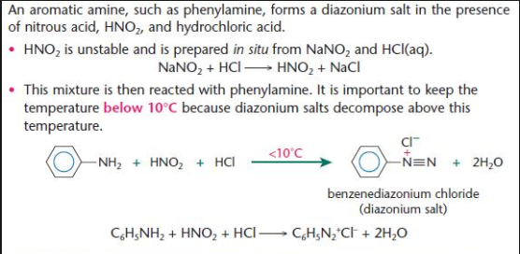

Slide 8
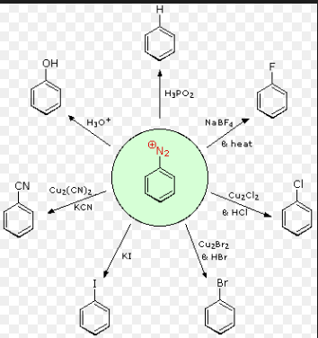
CHEMICAL PROPERTIES DIAZONIUM SALTS

Slide 9
REACTION INVOLVING RETENTION OF DIAZO GROUP

